Slide 1
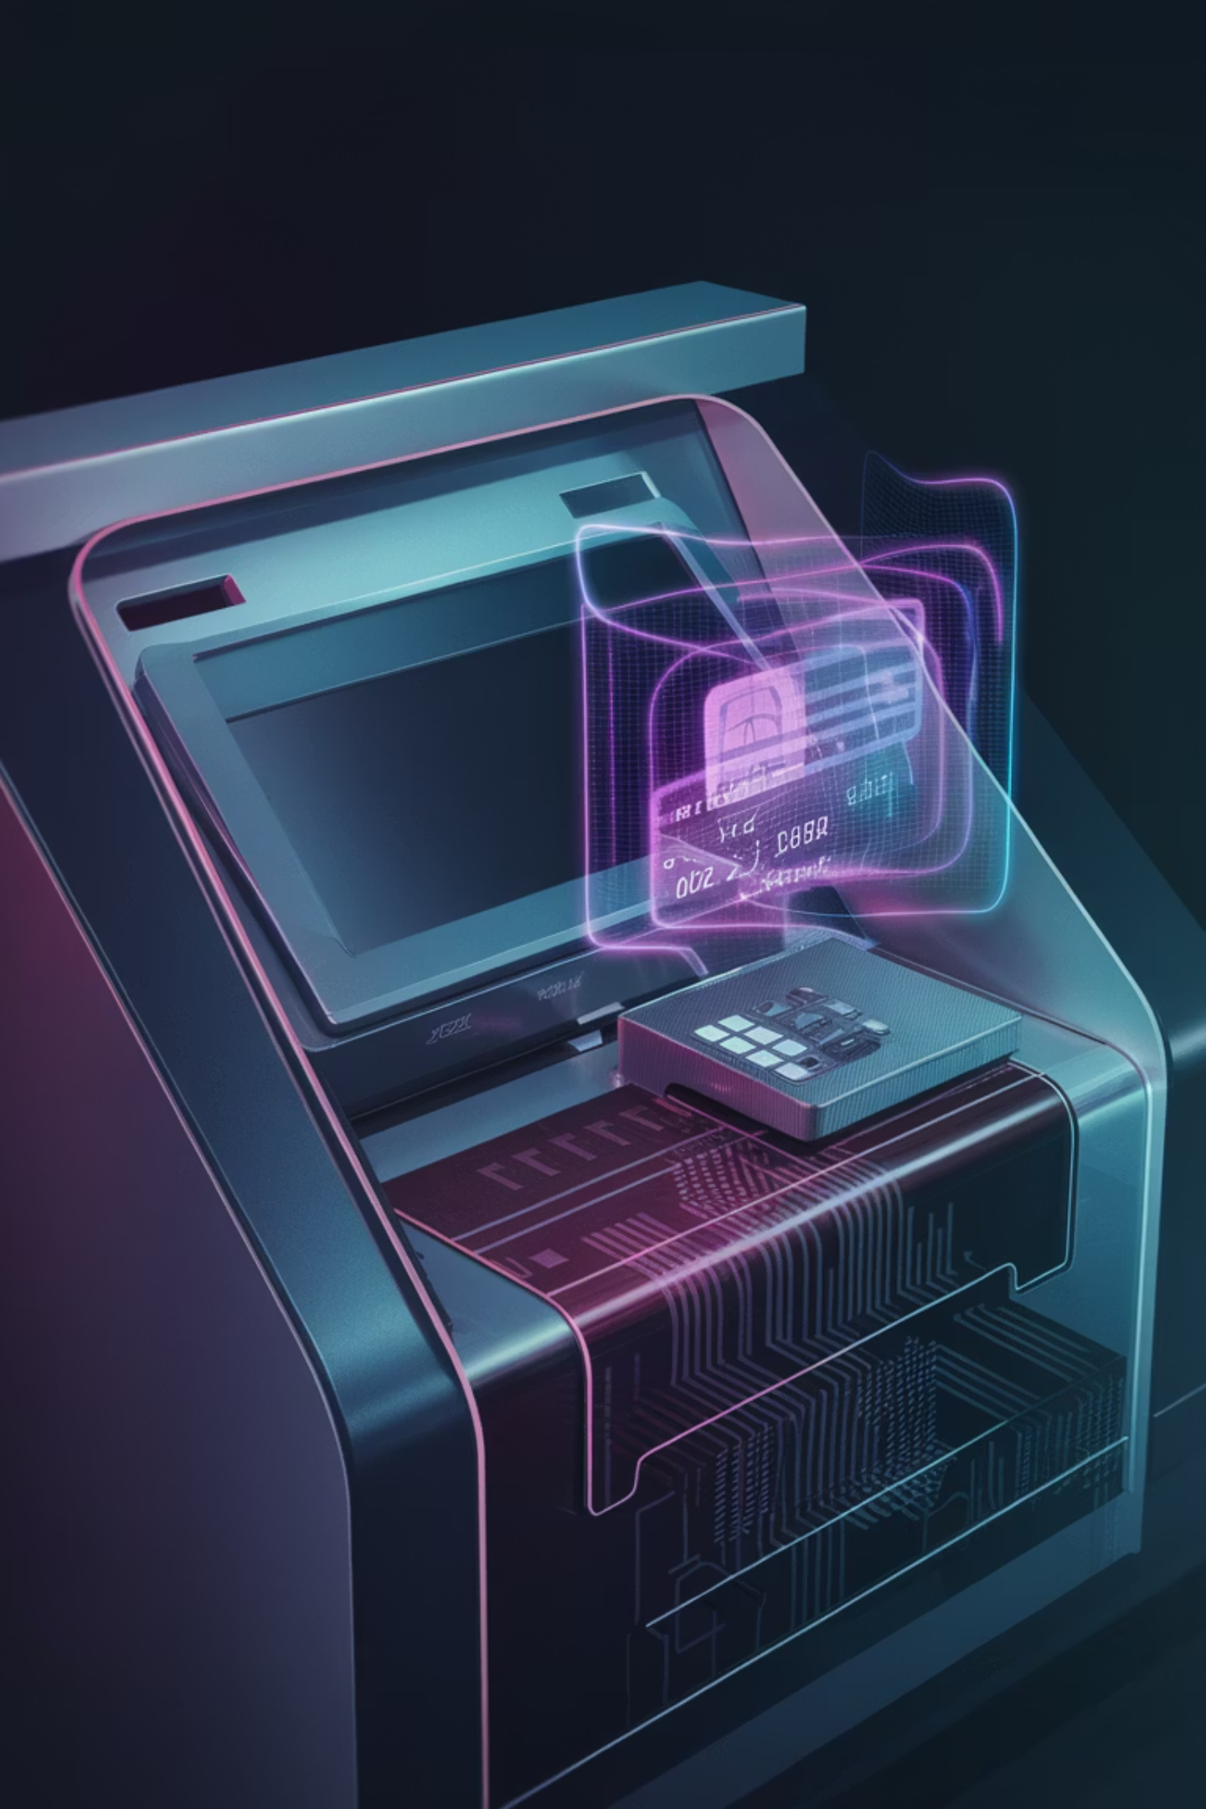
How to Hack an ATM Machine: Dispensing Cash on Demand
Exploring Exploitation Methods and Stealth Tactics for ATM Hacking.
By: Dennis Freyman

Slide 2

Prefaces and Notes
Dont do any of this pls dont steal money and if u do its not my fualt
Everything in this presentation is very broad and more theoretical then practical, not because a practical version isn't achievable, but because it wouldn't be that hard to do, and also
there are a lot of methods i wanna cover so that allows for less description of each
methods/slides ordered in order of least to most practical
pls dont steal money

Slide 3

Slide 2: Security Challenges and Shortcomings
Pro: 24/7
ATMs are lucrative targets due to their 24/7 operation, accessible locations, and often outdated security systems.
Pro: Legacy Software
Many ATMs run legacy software like Windows XP or Windows 7, which contain well-documented vulnerabilities.
Con: Balance Efficiency with Stealth
Attackers must balance efficiency with stealth, as banks monitor for irregular activity both digitally and physically.

Slide 4
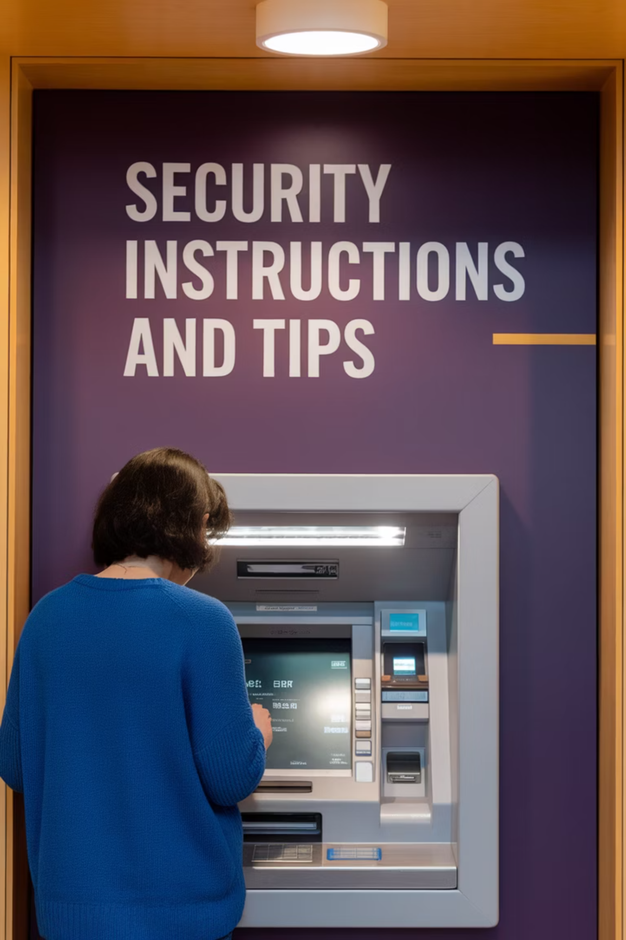
ATM Skimming (Low Practicality)
Pros
Cons
Requires minimal technical expertise and can target multiple ATMs simultaneously.
Limited in payout, as it relies on the number of cards skimmed and withdrawals made.
Can be hard for users to detect; skimmers are often disguised as legitimate ATM components.
Skimmers can be discovered quickly by vigilant ATM users or maintenance staff.
Not actually intruding the ATM, so lowers chances of detection via some kind of alarm
Increasingly ineffective due to chip-based cards and enhanced ATM security measures.

Slide 5

Step-by-Step: How to Perform ATM Skimming
Preparation
Data Collection:
Acquire or build a skimming device. These include a card reader overlay and a small camera or keypad overlay to capture PINs.
Monitor the skimmer regularly to retrieve card data and PIN codes.
Transfer the data to blank cards for unauthorized withdrawals.
Test the device to ensure it looks inconspicuous and functions effectively.
1
2
3
4
Installation:
Removal:
Install the skimmer over the ATM's card slot and position the camera or keypad overlay to record users entering their PINs.
Remove the skimming device promptly to avoid detection and forensic examination.
Ensure the device blends in with the ATM's design to avoid suspicion.

Slide 6

Real-World Example of ATM Skimming
In 2018, law enforcement uncovered a global skimming operation led by Eastern European criminals.
(Yes it was the Russians)
Skimmers installed on ATMs in tourist-heavy areas collected data from thousands of unsuspecting users.
Criminals used the stolen data to clone cards and withdraw millions of dollars from compromised accounts.
Many remain unfound, as when performed correctly this method is hard to detect as time passes.

Slide 7


Network Exploitation (Mid practicality)
Pros:
Cons:
Can be performed remotely, reducing the risk of physical detection.
Requires technical expertise and knowledge of ATM network configurations.
Highly scalable; can target multiple ATMs in a network simultaneously.
May trigger intrusion detection systems (IDS) if the malware is detected.
Effective against poorly secured or unencrypted ATM-to-bank communication channels.
Need to actually be there to collect the cash anyway, and kind of close to sniff traffic

Slide 8
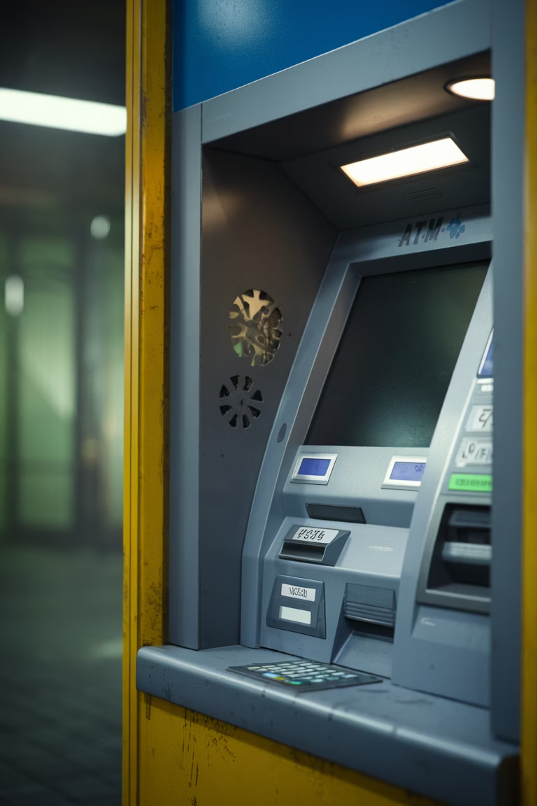
Step-by-Step: How to Perform Network Exploitation
1. Preparation:
2. Interception:
Use tools like Nmap to identify the ATM’s IP and open ports.
Use a tool like Wireshark to sniff unencrypted traffic and capture sensitive data (e.g., admin credentials).
Gather vulnerabilities in remote desktop protocols or ATM software w/ OSINT
3. Deploying Malware:
4. Command Execution: Error
Use frameworks like Metasploit to exploit vulnerabilities and install malware remotely.
Use the installed malware to issue commands, triggering cash dispensing.
5. Covering Tracks:
Clear logs and terminate unauthorized connections to avoid detection.
Snap shot system can also be used here, but harder to implement due to remote connection.

Slide 9




Real-World Example of Network Exploitation
When
In 2019, hackers exploited weak network protocols in ATMs across Europe.
Vuln
Attackers used remote desktop vulnerabilities to gain control of ATM software.
Banks
The operation resulted in massive losses, forcing banks to overhaul their network security systems.

Slide 10
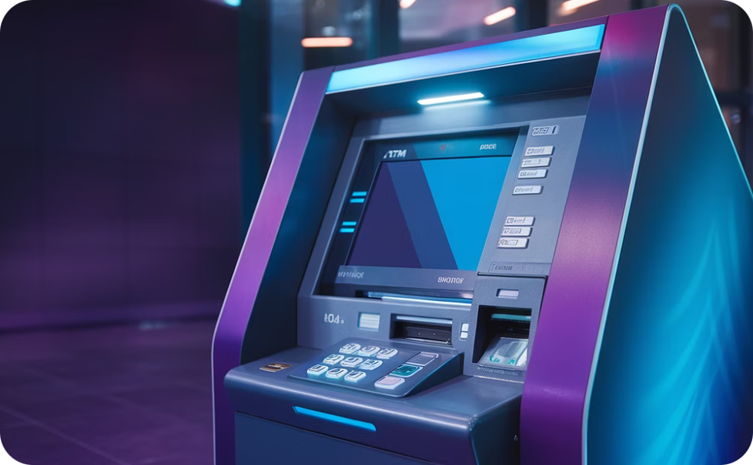
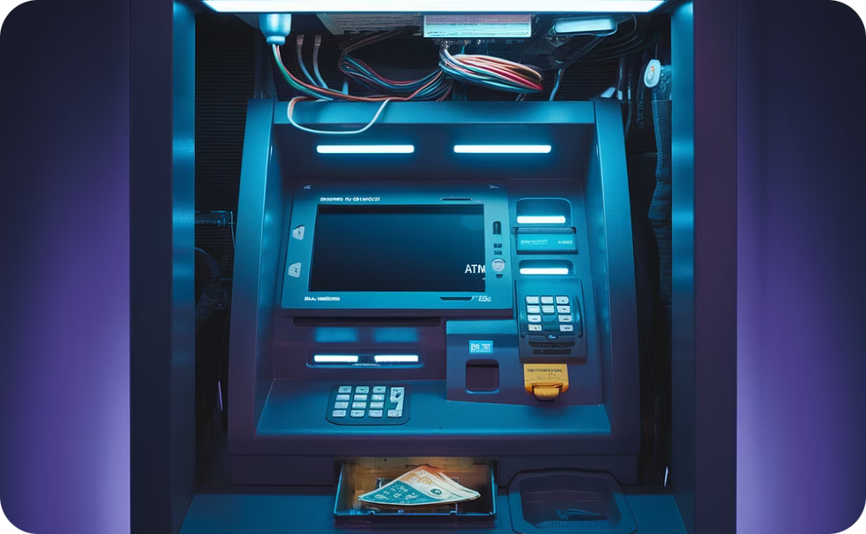
USB Exploitation (Mid Practicality)
Pros:
Cons:
Easy to execute if the ATM has accessible USB ports.
Requires physical access to the ATM, increasing the risk of detection.
Requires minimal technical skill if using pre-made malware like Ploutus-D.
Modern ATMs may have USB ports disabled or shielded behind tamper-resistant enclosures.
Effective even on outdated ATMs that lack physical port protections.
Malware may fail if the ATM has updated security patches or endpoint protection software.

Slide 11

Step-by-Step: How to Perform USB Exploitation
1
Preparation:
2
Gaining Access:
Acquire malware like Ploutus-D or Cutlet Maker and load it onto a USB drive.
Use lock-picking tools or screwdrivers to open the ATM’s external panels and expose the USB port.
Scout the ATM location to identify accessible USB ports behind panels.
3
Installing Malware:
4
Dispensing Cash:
Insert the USB drive and wait for the malware to auto-execute or manually run it using a connected laptop.
Interact with the ATM via the keypad or an external device to command the ATM to dispense cash.
5
Covering Tracks:
Always wear gloves to avoid leaving fingerprints and use disposable tools to prevent forensic tracing.
Equip the USB drive with malware that includes a snapshot feature. This feature takes a backup of the system state before modifications and restores it after the attack
Exit the area immediately after the malware finishes execution

Slide 12
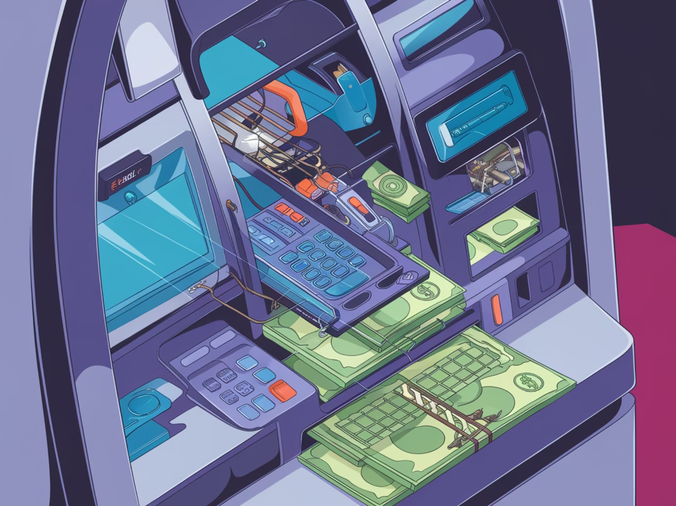
Real-World Example of USB Exploitation
There were arrests in Czech Republic (3), Estonia (4), France (11), the Netherlands (2), Romania (2), Spain (2) and Norway (3).
The ATM "Black Box" phenomenon first appeared in Western Europe in 2015, but most arrests took place in 2016 and 2017
Attackers physically accessed USB ports and installed the malware.
Once installed, Ploutus-D allowed attackers to remotely issue commands, making the ATMs dispense cash without logging the transactions.
The attack caused millions of dollars in losses and highlighted the vulnerability of USB ports in ATMs.

Slide 13
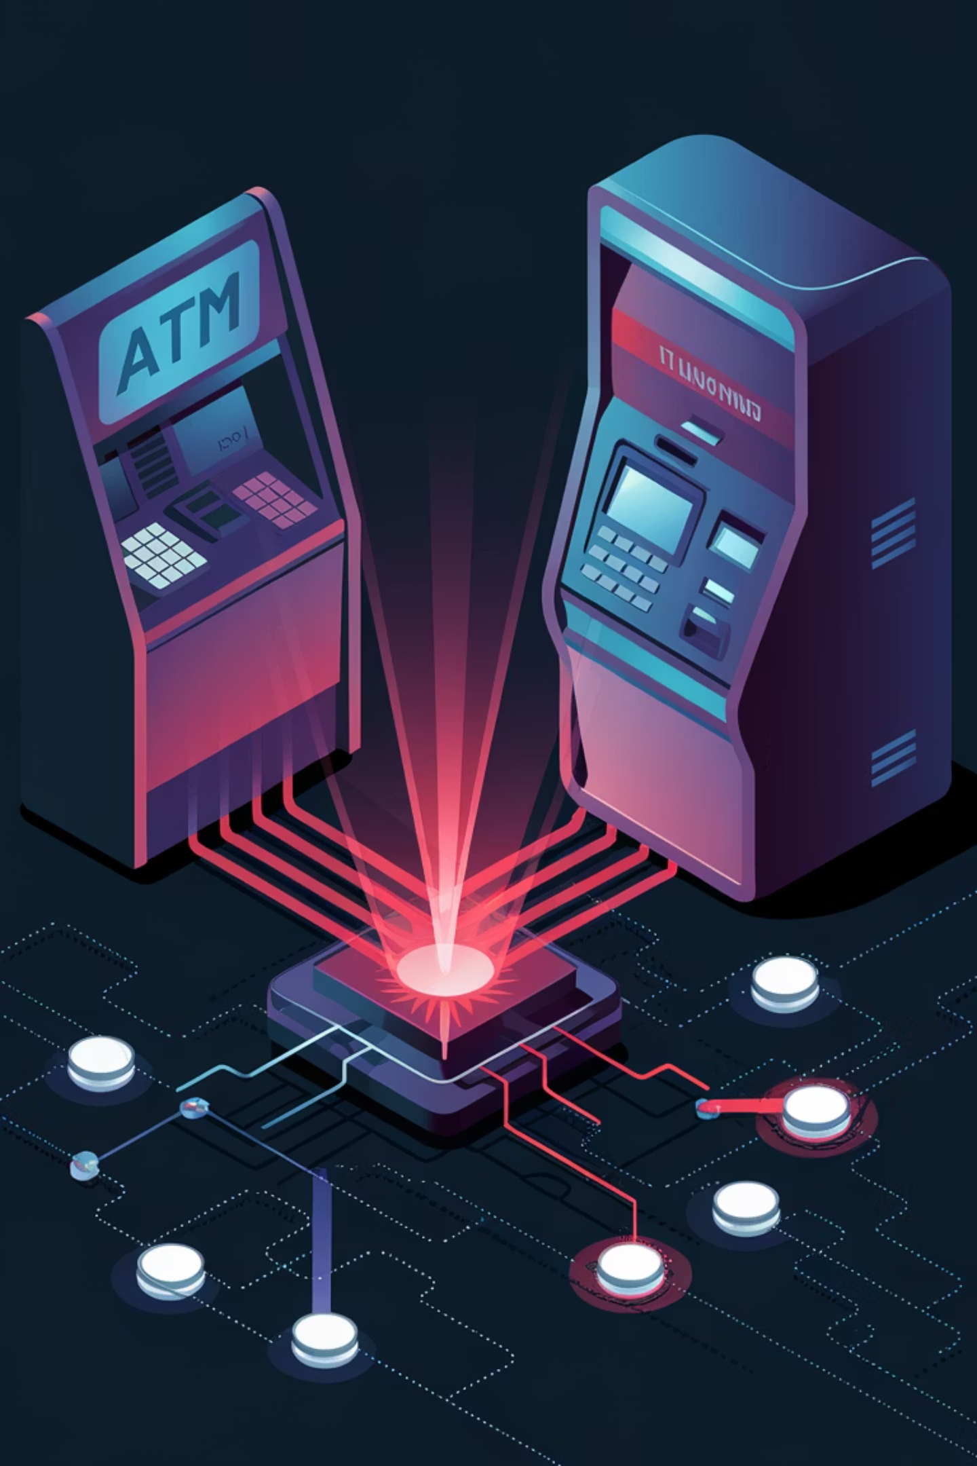
Phishing-Based Attacks (High Practicality)
Pros:
Cons:
People are really stupid
Relies on human error, as employees must open the malicious email or attachment.
Highly scalable and can target multiple people at once
Bypasses physical security measures entirely by focusing on people as the vulnerability
(this can be a negative if the people you are targeting have an IQ of greater then a braindead chipmunk)

Slide 14

Step-by-Step: How to Use Phishing for ATM Exploitation
1
Crafting the Email/Outreach:
2
Gaining Access:
Create a realistic phishing email posing as an IT department or trusted partner.
Wait for an employee to open the email and infect their computer with malware.
Attach malware-laden files (e.g., disguised as invoices or updates) or include malicious links.
Use the malware to pivot into the bank’s internal network.
3
Compromising the ATM Switch:
4
Executing the Attack:
Identify the ATM switch, which processes withdrawal approvals.
Coordinate withdrawals from multiple ATMs simultaneously to maximize the payout.
Manipulate the switch software to approve unauthorized ATM withdrawals on demand.
5
Covering Tracks:
Use the malware to erase its presence from the compromised systems after execution.

Slide 15
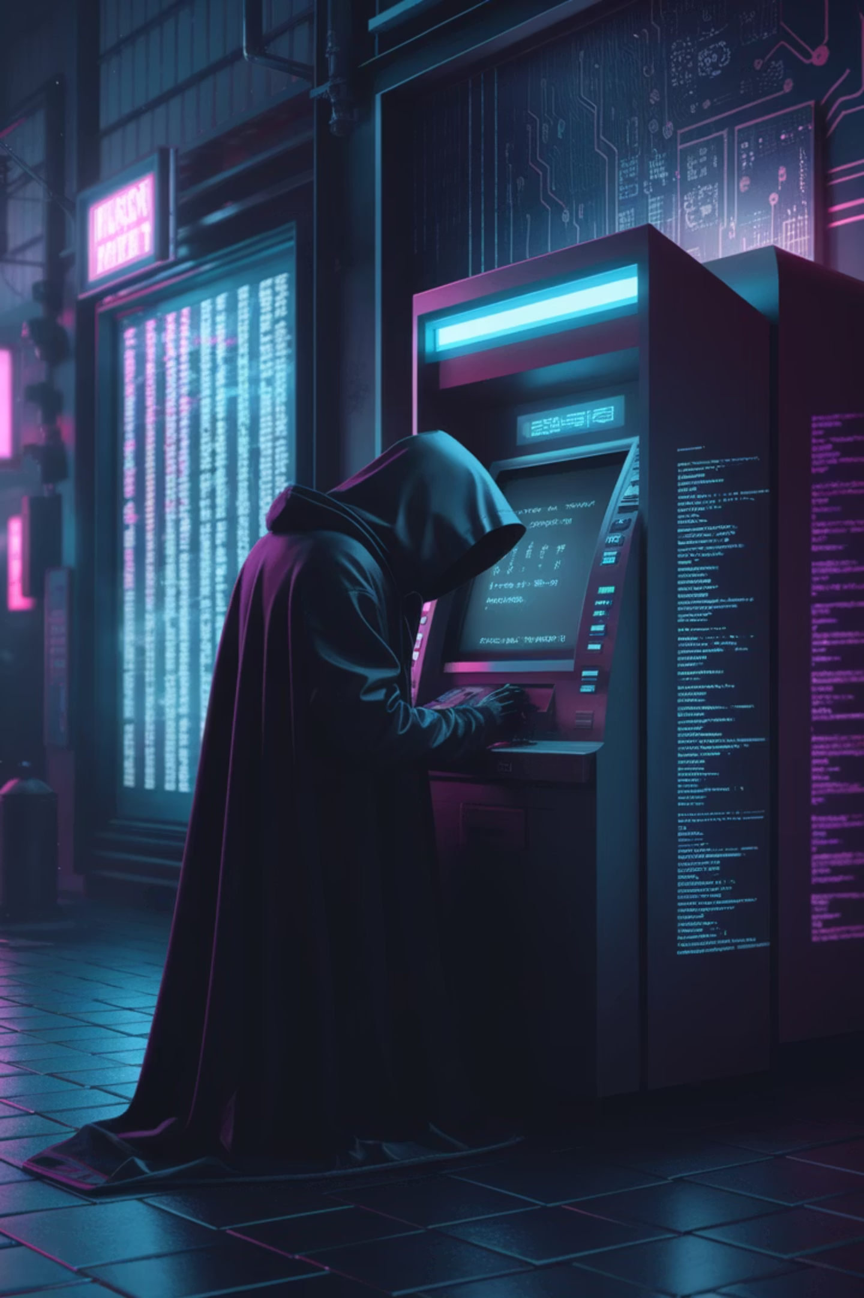




Real-World Example of Phishing Email
When?
What was stolen
In 2019, jackpotting attacks in Europe exploited unsecured network connections.
The intercontinental ATM theft that netted $14m in two hours
Scale
Were they caught?
It was a crime characterised by its grand scale and meticulous synchronisation. Criminals had plundered ATMs in 28 different countries, including the United States, the UK, the United Arab Emirates and Russia. It all happened in the space of just two hours and 13 minutes
Using the CCTV footage as well as mobile phone data from the areas near the ATMs, the investigators were able to arrest 18 suspects in the weeks after the raid. Most are now in prison.
(it was the north koreans)

Slide 16

DON'T LAUNDER MONEY

Slide 17
Money Laundering Techniques
Smurfing (Structuring Transactions)
Using Shell Companies
Cryptocurrency Conversion
High-Value Purchases and Resale
Register a shell company in a jurisdiction with lax financial regulations.
Use stolen funds to purchase cryptocurrency on exchanges that require minimal identity verification.
Identify multiple bank accounts, preferably under different names or entities.
Use stolen funds to purchase high-value items such as watches, artwork, vehicles, or electronics.
Open business bank accounts to receive and deposit stolen funds.
Deposit amounts below the reportable threshold (e.g., $10,000 in the US) into each account.
Transfer cryptocurrency to a mixing service (crypto tumbler) to hide the origin of the funds.
Make purchases at different locations to avoid drawing attention.
Fabricate invoices or receipts to justify deposits as business revenue.
Transfer funds between accounts to further obfuscate their origin.
Exchange the mixed cryptocurrency into different currencies on separate platforms.
Resell the items through legitimate channels, such as online marketplaces or auction houses.
Transfer funds internationally or use them to purchase assets under the company’s name.
Withdraw funds in a different jurisdiction or mix them with legitimate earnings.
Withdraw cleaned cryptocurrency into wallets or convert it back into fiat currency via offshore exchanges.
Deposit the proceeds into bank accounts, blending them with legitimate earnings.

Slide 18
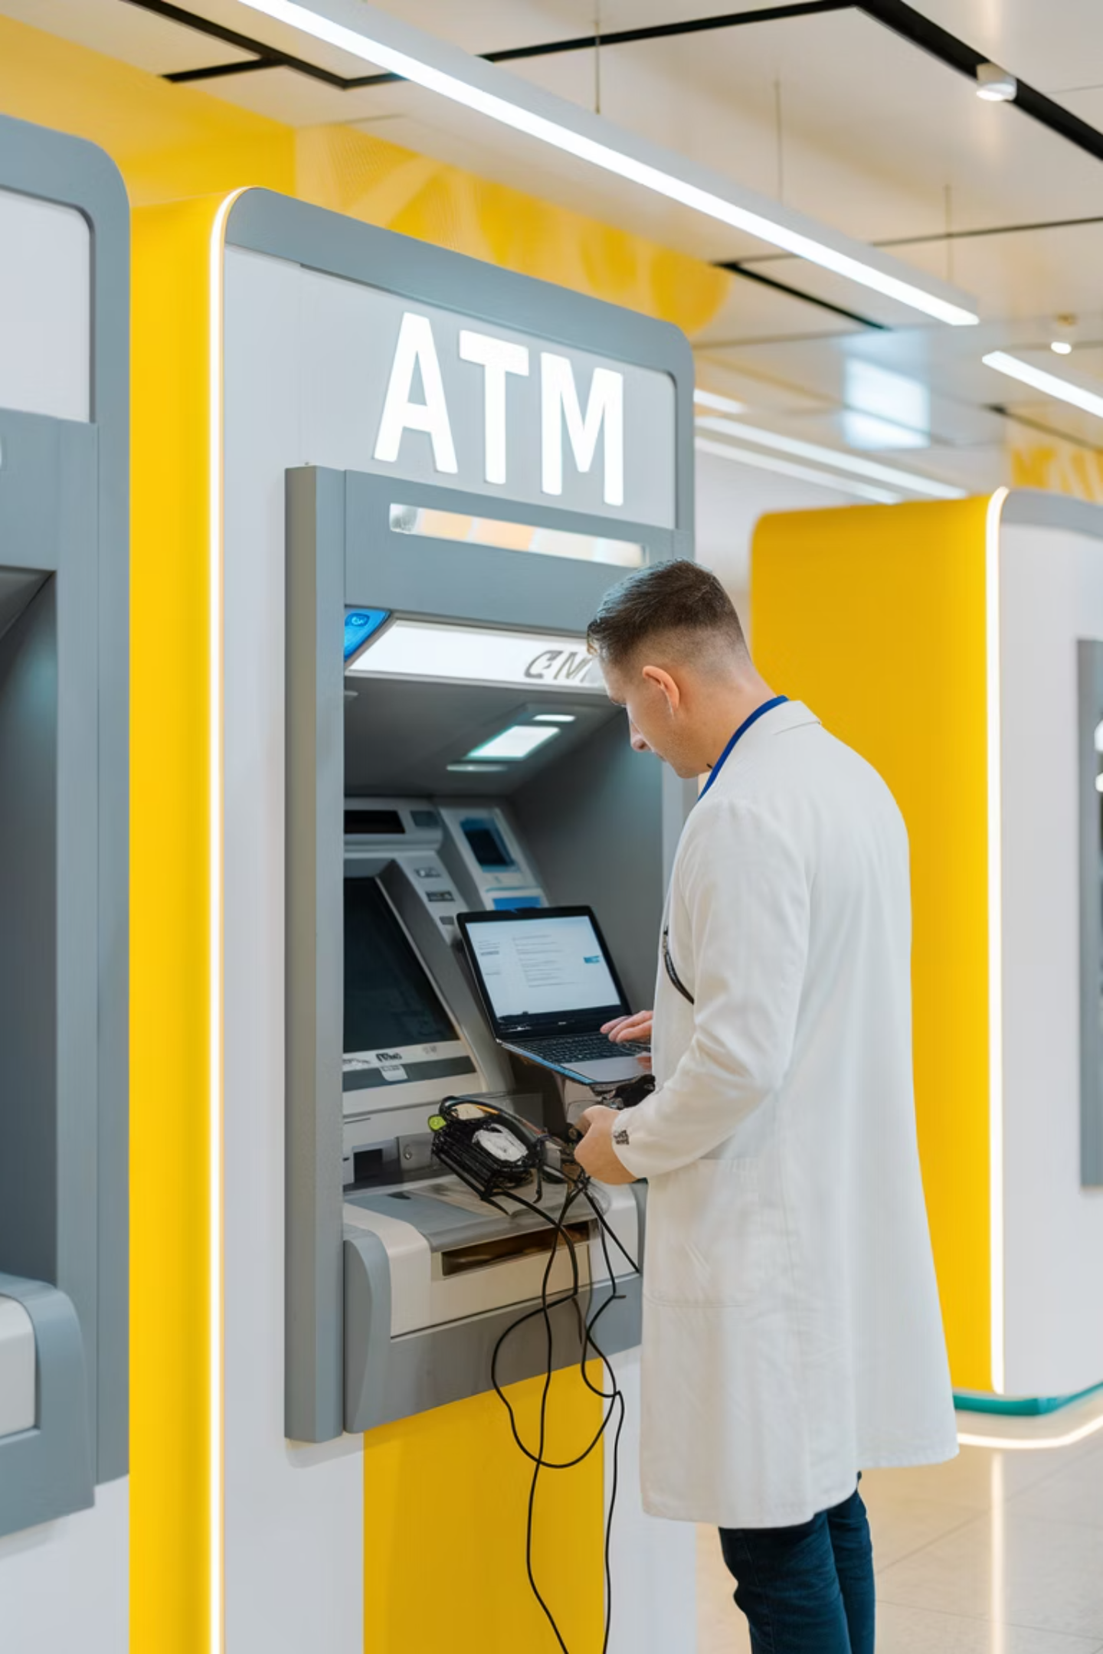



Why are these hacking methods important to consider? How can they be used well?
Authorized Access
Ethical hackers work with ATM operators to identify vulnerabilities through authorized penetration testing.
Risk Assessment
Thorough security audits help ATM owners understand their exposure and prioritize countermeasures.
Secure Development
Ethical hackers can assist with secure software development and configuration for ATM systems.

Slide 19

Thank You!

